Slide 1
Exploratory Data Analysis of Cricket Matches

Slide 2
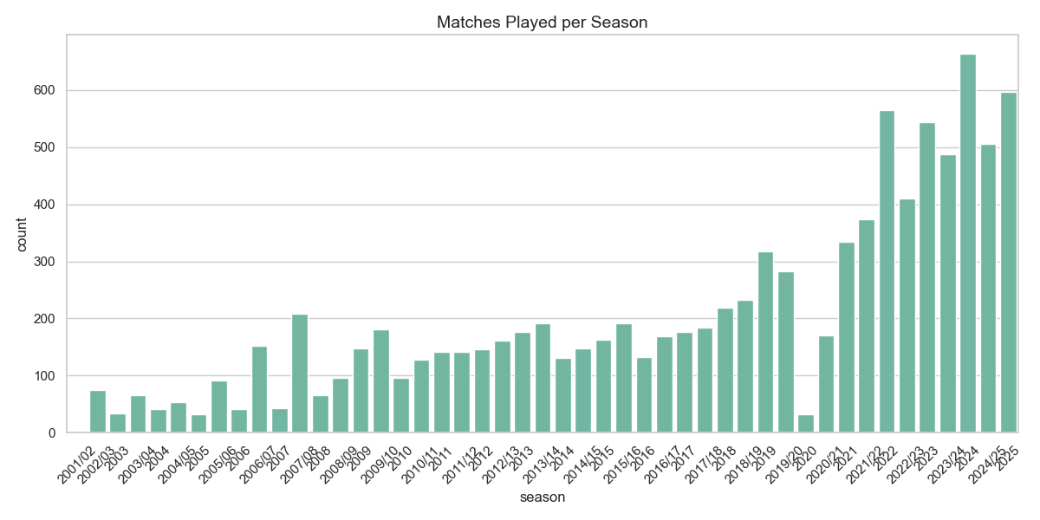
Matches Played per Season
Shows the growth/variation of matches over seasons.
Helps identify busiest cricket years.
Useful for trend analysis across time.

Slide 3
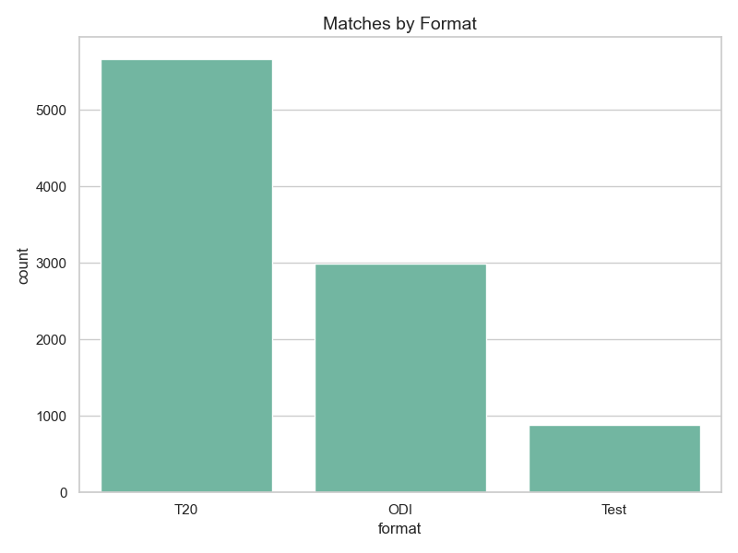
Matches by Format (ODI, T20, Test)
Distribution of matches across formats.
Indicates popularity & scheduling trends.
Helps compare short vs long formats.

Slide 4
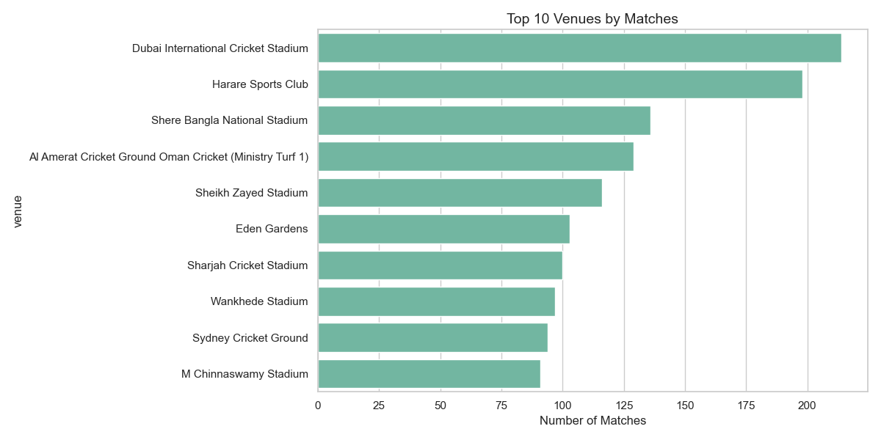
Top 10 Venues by Matches
Most frequently used stadiums.
Highlights cricket hotspots.
Venue preference impacts team strategy.

Slide 5
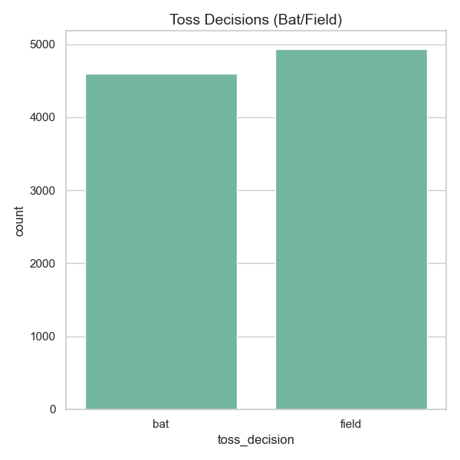
Toss Decisions (Bat vs Field)
Shows team preferences after winning toss.
Identifies batting/fielding trends.
Insights into match strategy evolution.

Slide 6
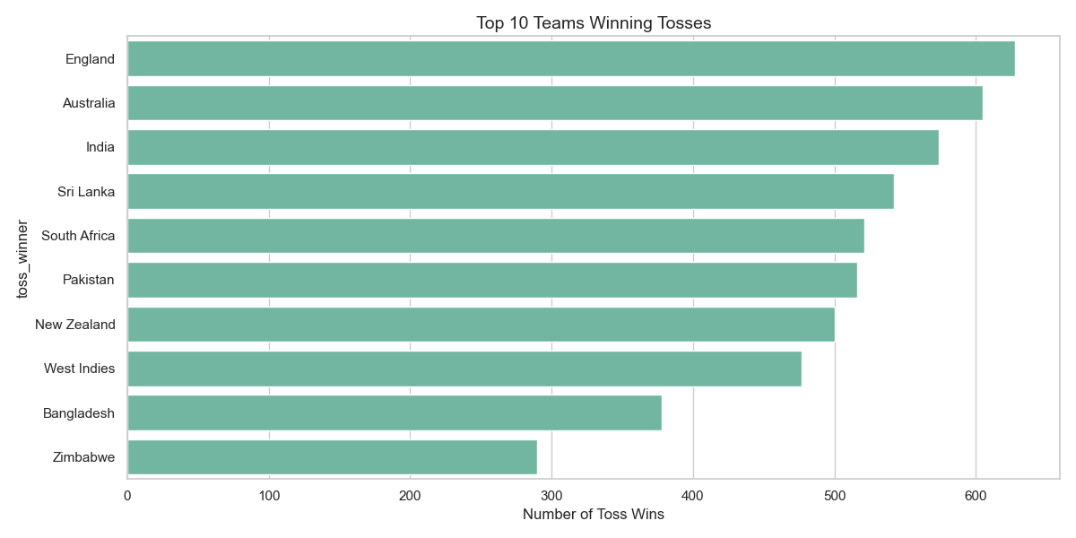
Teams Winning Most Tosses
Top 10 teams with highest toss wins.
Toss often influences match outcomes.
Key factor in high-pressure games.

Slide 7
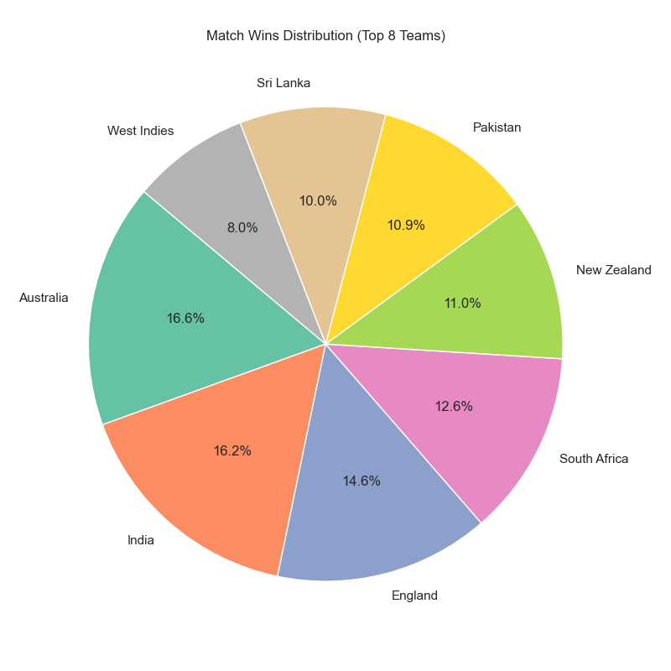
Match Wins Distribution
Top 8 teams with most match wins.
Pie chart shows dominance of certain teams.
Useful for performance benchmarking.

Slide 8
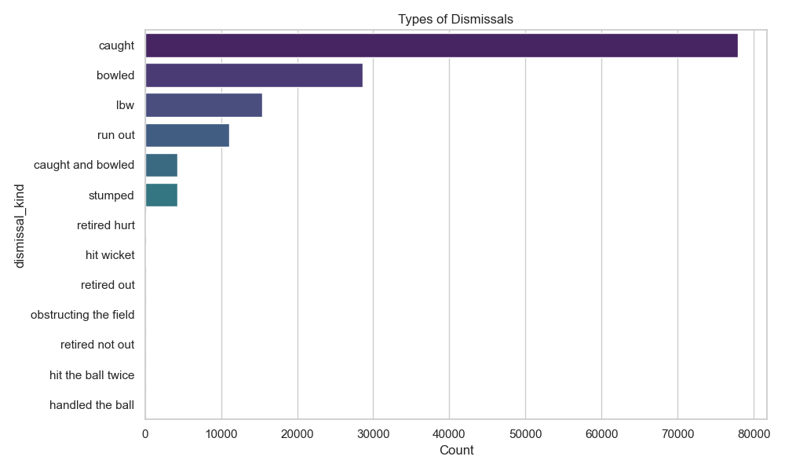
Types of Dismissals
Most common ways batsmen get out.
“Caught” usually dominates in cricket.
Insights for bowlers & coaches.

Slide 9
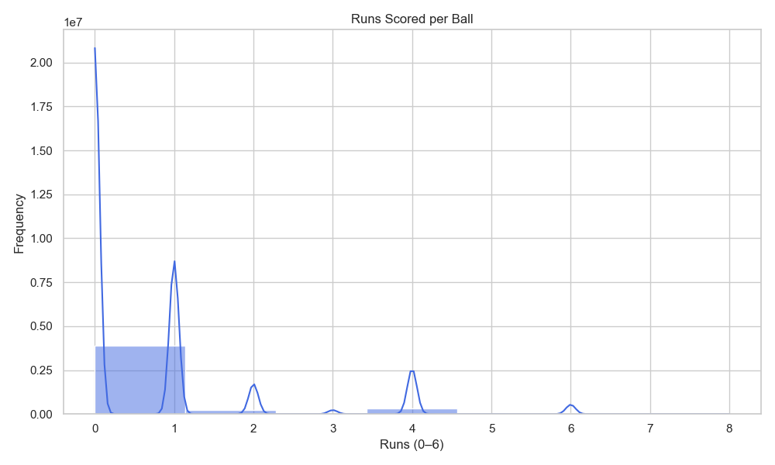
Runs per Ball Distribution
Frequency of 0,1,2,3,4,6 runs per delivery.
0 & 1 run are most common outcomes.
Useful for batting efficiency analysis.

Slide 10
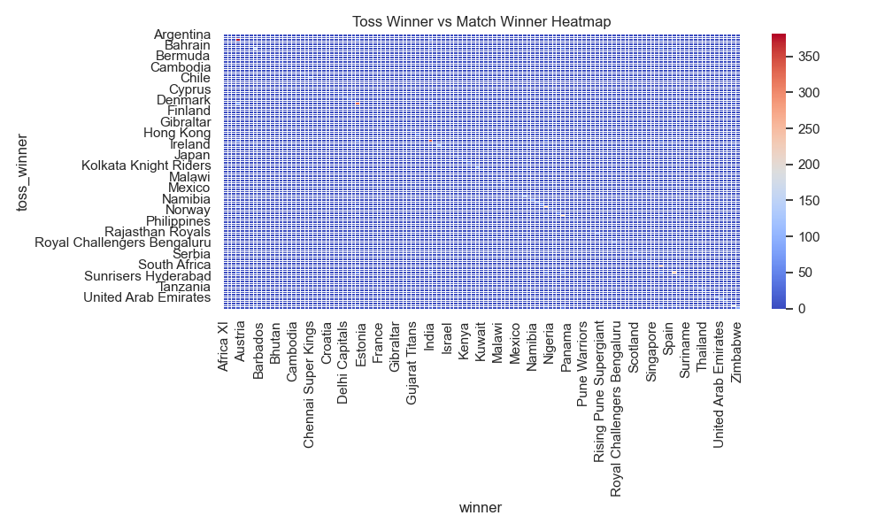
Toss Winner vs Match Winner Heatmap
Relationship between toss results & match outcomes.
Shows whether toss advantage converts to match wins.
Helps test “toss bias” theories.

Slide 11
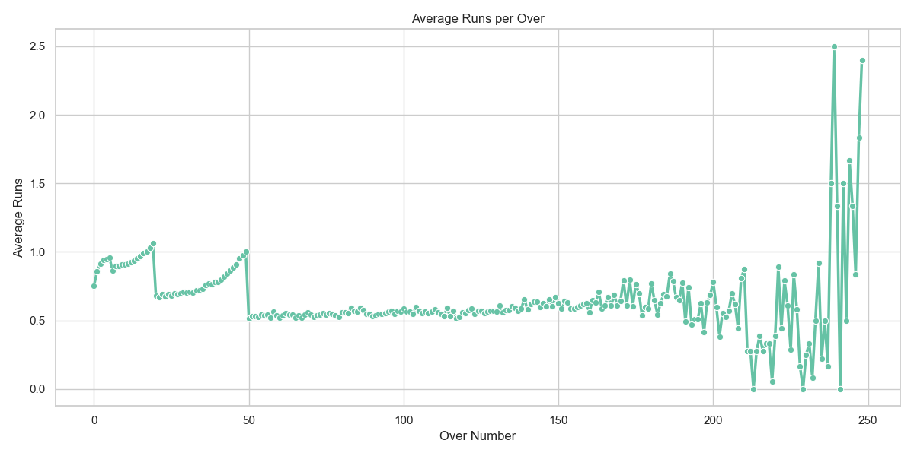
Average Runs per Over
Line chart showing run-scoring trends per over.
Early overs vs death overs comparison.
Useful for strategy in T20 matches.

Slide 12
Thank you!

